Slide 1

CSCI 4502/5502
Data Mining - Fall 2023 - Lecture 18
Ravi Starzl, PhD

Slide 2
1
Outlier & outlier analysis
Chapter 12:
Outlier Analysis
2
Statistical approaches
3
Proximity-based approaches
4
Clustering-based approaches
Classification-based approaches
5
Mining contextual and collective outliers
6
7
Outlier detection in high dimensional data
Ravi Starzl, PhD - Data Mining Fall 2023

Slide 3

Types of Outliers
Global outliers (point anomaly)
different from the rest of the data set
Contextual outliers (conditional outlier)
contextual vs. behavioral attributes; e.g., 30-minute commute
Collective outliers
a subset of objects; e.g., over 100 delayed flights
Ravi Starzl, PhD - Data Mining Fall 2023
Notes:
Global Outliers (Point Anomaly):
These are data points that are significantly different from the rest of the dataset.
They stand out from the rest because they do not follow the expected pattern or trend.
Identifying global outliers is important because they can indicate errors in data collection, or they might signify a discovery or a new trend.
Contextual Outliers (Conditional Outlier):
Contextual outliers are data points that are considered anomalous given a specific context.
This category is split into two attributes: contextual and behavioral.
For example, a 30-minute commute might be typical in a rural area but considered an outlier in a city where the average commute is much shorter.
Collective Outliers:
These outliers are a subset of data points that collectively deviate from the overall pattern in the dataset.
They may not be outliers when examined individually, but as a group, they are unusual.
For instance, if there are over 100 delayed flights on a particular day, each delayed flight isn't necessarily an outlier, but the sheer number of them is an anomaly.
Types of Outliers:
Outliers can be classified based on the deviation from what is normal or expected in the dataset.
Recognizing the type of outlier is crucial for proper analysis, as the method for handling outliers can differ.
Outliers can influence statistical analyses and models, potentially leading to incorrect conclusions if not addressed appropriately.

Slide 4

Outlier Detection Challenges
Modeling normal objects and outliers
difficult to enumerate all normal cases
Handling noise in outlier detection
Application-specific outlier detection
e.g., clinic data vs. marketing analysis
Handling noise in outlier detection
blur the normal vs. outlier distinction
Understandability
justification, degree of outlier
Ravi Starzl, PhD - Data Mining Fall 2023
Notes:
Modeling Normal Objects and Outliers:
It can be challenging to create models that accurately represent both normal data points and outliers.
In many cases, it is difficult to define all possible normal cases due to the variability and complexity of data.
This complexity makes it hard to distinguish between data that is genuinely abnormal and data that is simply uncommon.
Handling Noise in Outlier Detection:
Noise can complicate outlier detection because it can obscure the boundary between normal data and actual outliers.
It's important to differentiate between noise – which might just be random variations or unexplained variations in the data – and true outliers, which could be indicative of a significant issue or event.
Noise can lead to false positives (normal points labeled as outliers) or false negatives (outliers labeled as normal).
Application-Specific Outlier Detection:
Outlier detection must often be tailored to the specific context of the application, as what constitutes an outlier can vary greatly from one domain to another.
For example, outlier detection in clinical data (like identifying unusual patient results) requires a different approach than in marketing analysis (like spotting unusual purchasing behavior).
Each field may have its own definition of what is normal and what is an outlier, making it necessary to customize the detection methods accordingly.
Handling Noise in Outlier Detection (Reiterated):
Again, noise can make it hard to determine the line between normal behavior and outliers.
The presence of noise in the data may lead to a blurred distinction, making the outlier detection process more complex.
Effective noise management is crucial for maintaining the integrity of the outlier detection process.
Understandability:
When outliers are detected, it's important to provide justification for why they are considered outliers.
The degree of outlierness should be quantifiable to help understand how far from normal an outlier is.
Clear explanations for the designation of outliers help in making informed decisions, especially when it comes to determining whether to include or exclude them from further analysis.

Slide 5

Outlier Detection Methods
Whether user labels are available
supervised
semi-supervised
unsupervised
Assumptions about normal data and outliers
statistical (model-based)
proximity-based
clustering-based
Ravi Starzl, PhD - Data Mining Fall 2023
Notes:
Based on the Availability of User Labels:
Supervised: These methods require a labeled dataset with both normal cases and outliers to train the model. The model learns to distinguish between the two during the training process.
Semi-Supervised: This approach only requires labels for the normal data. The model is trained to recognize the patterns of normality, and anything that deviates significantly from this pattern is considered an outlier.
Unsupervised: No labels are needed for this method. The model attempts to understand the data's structure and identify outliers based on deviations from the established normal patterns.
Based on Assumptions About Normal Data and Outliers:
Statistical (Model-Based): These methods assume that normal data follow some statistical distribution. Outliers are detected by identifying data points that have a low probability of belonging to the assumed distribution.
Proximity-Based: This approach relies on the proximity of data points to each other. Points that are far from their nearest neighbors are considered outliers.
Clustering-Based: In this method, data is grouped into clusters. Data points that do not belong to any cluster or are far from the centroids of their clusters are treated as outliers.

Slide 6
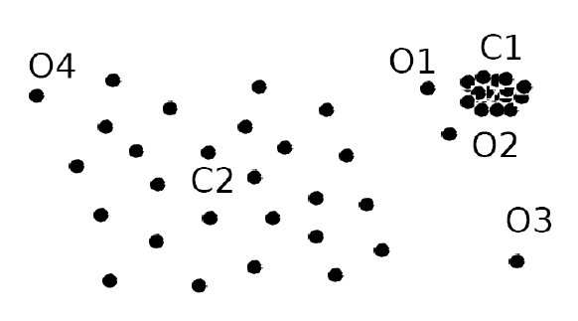
Proximity-based Approaches
Intuition: Obiects that are far away from the others are outliers
Distance-based
distance of the k-th nearest neighbor
or fraction of obis within distance r
Density-based
density around outlier
density of neighbors
Ravi Starzl, PhD - Data Mining Fall 2023
Notes:
Distance-based:
These methods define outliers as points that are far away from their neighbors.
One common technique is to calculate the distance to the
k-th nearest neighbor. If this distance exceeds a certain threshold, the data point can be considered an outlier.
Another variation is to look at the number of points within a certain radius (r) of a data point. If a point has significantly fewer neighbors within this radius than is typical for the dataset, it might be an outlier
Density-based:
Density-based methods contrast the density around a potential outlier with the density around its neighbors.
The basic idea is that the area around a normal data point is expected to have a similar density to the area around its neighbors, while the area around an outlier will have a much lower density.
This method is sensitive to regions of varying densities and is often used in datasets where the normal data points form clusters of varying shapes and sizes.

Slide 7
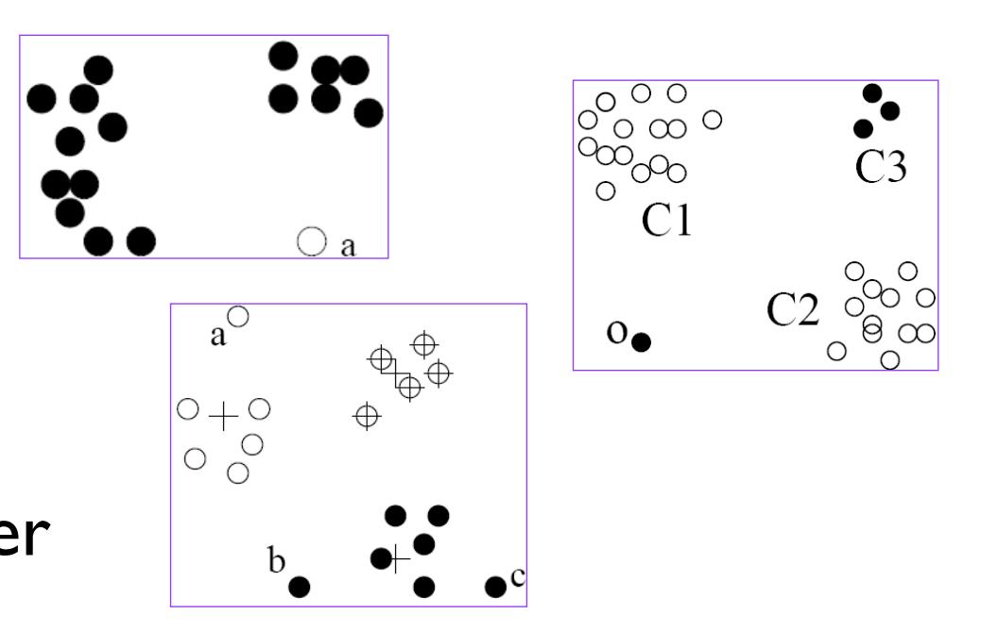
Clustering-based Approaches
An object is outlier if
does not belong to any cluster
Far from its closest cluster
belongs to a small or sparse cluster
Using training set to find patterns of normal data
Compare new obi w/ clusters
Ravi Starzl, PhD - Data Mining Fall 2023
Notes:
Non-membership to Any Cluster: If an object doesn't belong to any well-defined cluster, it may be considered an outlier. This means the point does not fall within the boundaries of any cluster formed from the data.
Distance from the Closest Cluster: An object may be considered an outlier if it is located far from the nearest cluster. Even if it's technically part of a cluster, its significant distance from the cluster center can still classify it as an outlier.
Membership in a Small or Sparse Cluster: Sometimes a point might be part of a cluster, but if this cluster contains very few points or the points are widely spread out (sparse), the entire cluster might be considered as a collection of outliers.
These approaches often involve a training phase, where the clustering algorithm is applied to a training set to find patterns of normal data. The clusters that emerge from this process are considered representations of normal behavior.
When new data points (objects) are observed, they are compared with the established clusters. If a new point falls significantly outside of these clusters, it can be flagged as an outlier. This comparison is usually based on the distance from the cluster centers or the density of the clusters.

Slide 8

Clustering-based Approaches
Strength
no labels required, support many data types
clusters are summaries of data
only need to compare obi to clusters (fast)
Weakness
effectiveness depends on clustering method
high computation cost: first find clusters
to reduce cost: e.g., fixed-width clustering
Ravi Starzl, PhD - Data Mining Fall 2023
Notes:
Strengths:
No Labels Required: These methods are unsupervised, so they don't require a labeled dataset. This makes them particularly useful when it is impractical or impossible to label data as normal or abnormal.
Support for Many Data Types: Clustering algorithms can often handle a variety of data types and structures, making them versatile for different kinds of datasets.
Clusters as Data Summaries: Clusters simplify the data by summarizing it into groups. This summary view can make it easier to understand and analyze the overall structure of the data.
Efficiency in Comparison: Once clusters are formed, detecting outliers is relatively fast because it only requires comparing new objects to existing clusters rather than to every single data point.
Weaknesses:
Dependence on Clustering Method: The effectiveness of outlier detection is highly dependent on the chosen clustering algorithm. Some clustering methods may not perform well with certain data distributions or may be sensitive to the initial parameters.
High Computational Cost for Clustering: Finding clusters can be computationally intensive, especially with large datasets. This initial step can be a significant overhead.
Fixed-Width Clustering to Reduce Costs: To address the high computational cost, some approaches, such as fixed-width clustering, have been developed. This method limits the size of clusters and can speed up the process by reducing the number of comparisons needed. However, it may not be as accurate or effective as other, more computationally intensive methods.

Slide 9
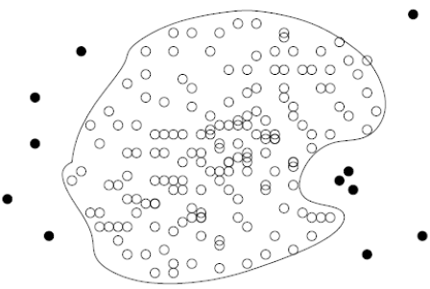
Classification-based Methods
Train a classification model that can distinguish normal data from outliers
Brute-force approach
labeled normal and outlier objects
skewed data, cannot detect unseen anomaly
One-class model
classifier for normal data
Ravi Starzl, PhD - Data Mining Fall 2023
Notes:
Brute-Force Approach:
This method requires a dataset with labels for both normal and outlier data points.
A classification model is trained on this labeled data, learning to differentiate between the two categories.
However, this approach has some limitations. It may not perform well with highly skewed data where outliers are rare, which can lead to a model that is biased towards predicting the majority class. Additionally, it may not be effective at detecting new types of anomalies that were not present in the training data.
One-Class Model:
A one-class classifier is trained only on the normal data. The model's task is to learn the distribution of the normal class.
New data points that do not fit the learned distribution are considered outliers.
This approach is particularly useful when you have a lot of data for the normal case but very few examples of outliers.
One-class models are often used in situations where anomalies are not well-defined or are too rare to allow for a conventional supervised learning approach.
In both cases, the success of the classification-based method heavily depends on the quality of the data and the features used to train the model. For the brute-force approach, a sufficiently representative set of outlier examples is crucial, while for the one-class model, the ability to capture the boundaries of normal behavior is key.

Slide 10
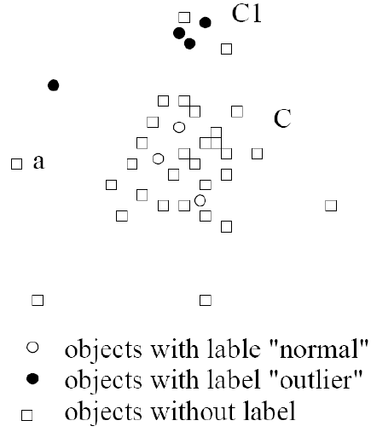
Semi-supervised Learning
Combine classification and clustering
Clustering to find large cluster C & small cluster CI
C: obis w/ normal label
﻿One-class model from C
CI: obs wl outlier label
Any obj not in C's model: identify as outlier
Ravi Starzl, PhD - Data Mining Fall 2023
Notes:
nitial Clustering Phase:
Perform clustering on the dataset to identify two types of clusters: a large cluster (C), which presumably contains the 'normal' data, and smaller clusters (CI), which may contain outliers.
Labeling:
Assign a 'normal' label to objects within the large cluster C, considering that these objects represent the majority pattern in the data.
Assign an 'outlier' label to objects within the small clusters CI, as these objects could represent deviations from the norm.
One-Class Classification:
Train a one-class classification model on objects from the large cluster C. This model learns to recognize the pattern of the normal data.
Detection:
For new objects or those not included in the initial clustering, apply the one-class model to determine if they fit the pattern of the large cluster C.
Any object that does not fit into the one-class model's pattern (i.e., is sufficiently dissimilar from the large cluster C) is identified as an outlier.
Semi-Supervised Learning:
This process is an example of semi-supervised learning because it involves using a large amount of unlabeled data (the initial clustering) and a small amount of labeled data (objects in CI given an outlier label) to train the model.

Slide 11
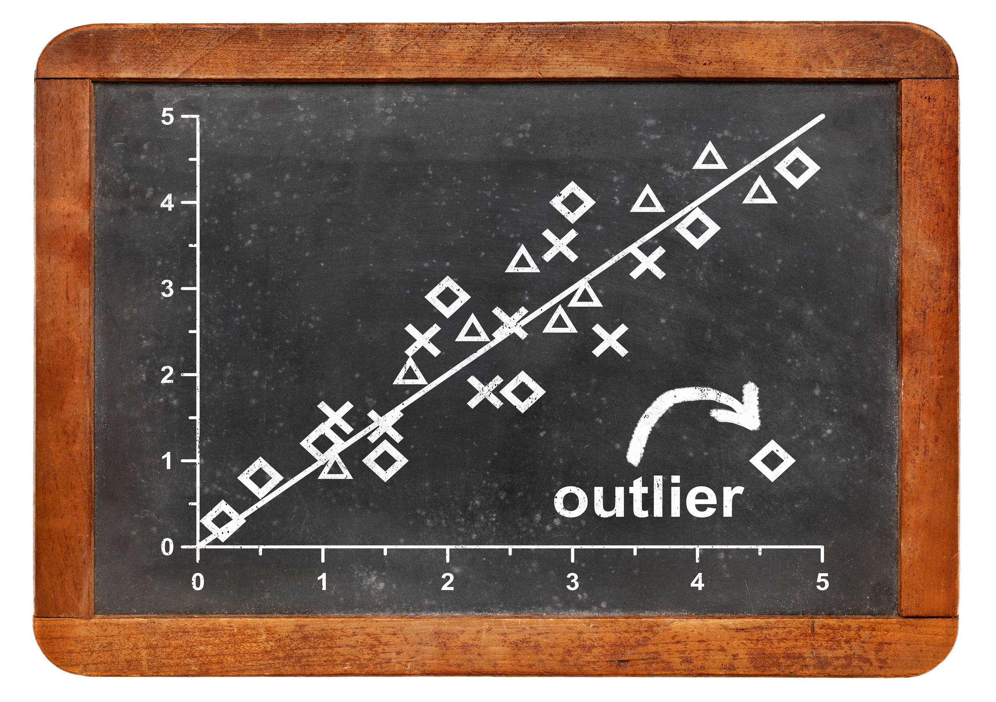
Contextual Outliers (1)
Transform to conventional outlier detection if the contexts can be clearly identified
identify the context of o
compare o wl others in the same context
use conventional outlierdetection
Generalize context if too few obiects in the same context
e.g., customers by age group
e.g., by geographic region
Ravi Starzl, PhD - Data Mining Fall 2023
Notes:
Context Identification:
First, clearly identify the context that is relevant for each object (denoted as
o). The context could be time, location, a specific group, or any other condition that can affect the data's interpretation.
Contextual Comparison:
Compare object
o with other objects within the same context. By doing this, you can assess whether
o is behaving similarly to its peers in the same situation or whether it stands out.
Conventional Outlier Detection:
Apply conventional outlier detection methods to the data, now segmented by context. This can include statistical tests, proximity-based methods, or any other appropriate outlier detection technique.
Generalizing Context:
In cases where there are too few objects within the same context to make a reliable comparison, it may be necessary to generalize the context. For example, if you have very few customers in a certain age group, you might expand the age range to include more customers in the comparison.
Another example is geographic regions. If a particular region has too few data points, you might expand the area or combine it with neighboring regions to ensure a sufficient sample for comparison.
Contextual Data Transformation:
When the context can be quantified or categorized, it may be possible to transform the data into a format that allows for conventional outlier detection methods. This could mean creating new features that represent the context or adjusting existing features to reflect the contextual information.

Slide 12

Contextual Outliers (2)
Modeling normal behavior with respect to contexts
Contextual attributes => behavior attributes
mixture model U on contextual attributes
mixture model V on behavior attributes
p(V_i|U_j)
Approaches
regression, Markov models, finite state automaton
Ravi Starzl, PhD - Data Mining Fall 2023
Notes:
Modeling Normal Behavior:
To detect contextual outliers, it's important to model what constitutes normal behavior within different contexts. This involves understanding how the context influences the expected behavior.
Linking Contextual and Behavioral Attributes:
Contextual attributes are those that define the situation or conditions under which the data is observed. Behavioral attributes are the actual data points or observations that may vary depending on the context.
To link these, one might use a mixture model for both contextual (denoted as U) and behavioral attributes (denoted as V). Mixture models can capture the complexities and variations in data by assuming that the data is generated from a mixture of several distributions.
Approaches for Modeling:
Various modeling approaches can be used to represent the relationship between context and behavior:
Regression models can predict behavioral attributes based on contextual attributes. They are useful when the relationship is expected to be linear or can be approximated as such.
Markov models are helpful in situations where the context changes over time, and the next state depends only on the current state (memoryless property).
Finite state automatons can model systems with a finite number of states and transitions. They are useful for systems where context and behavior follow a predictable set of rules or patterns.

Slide 13
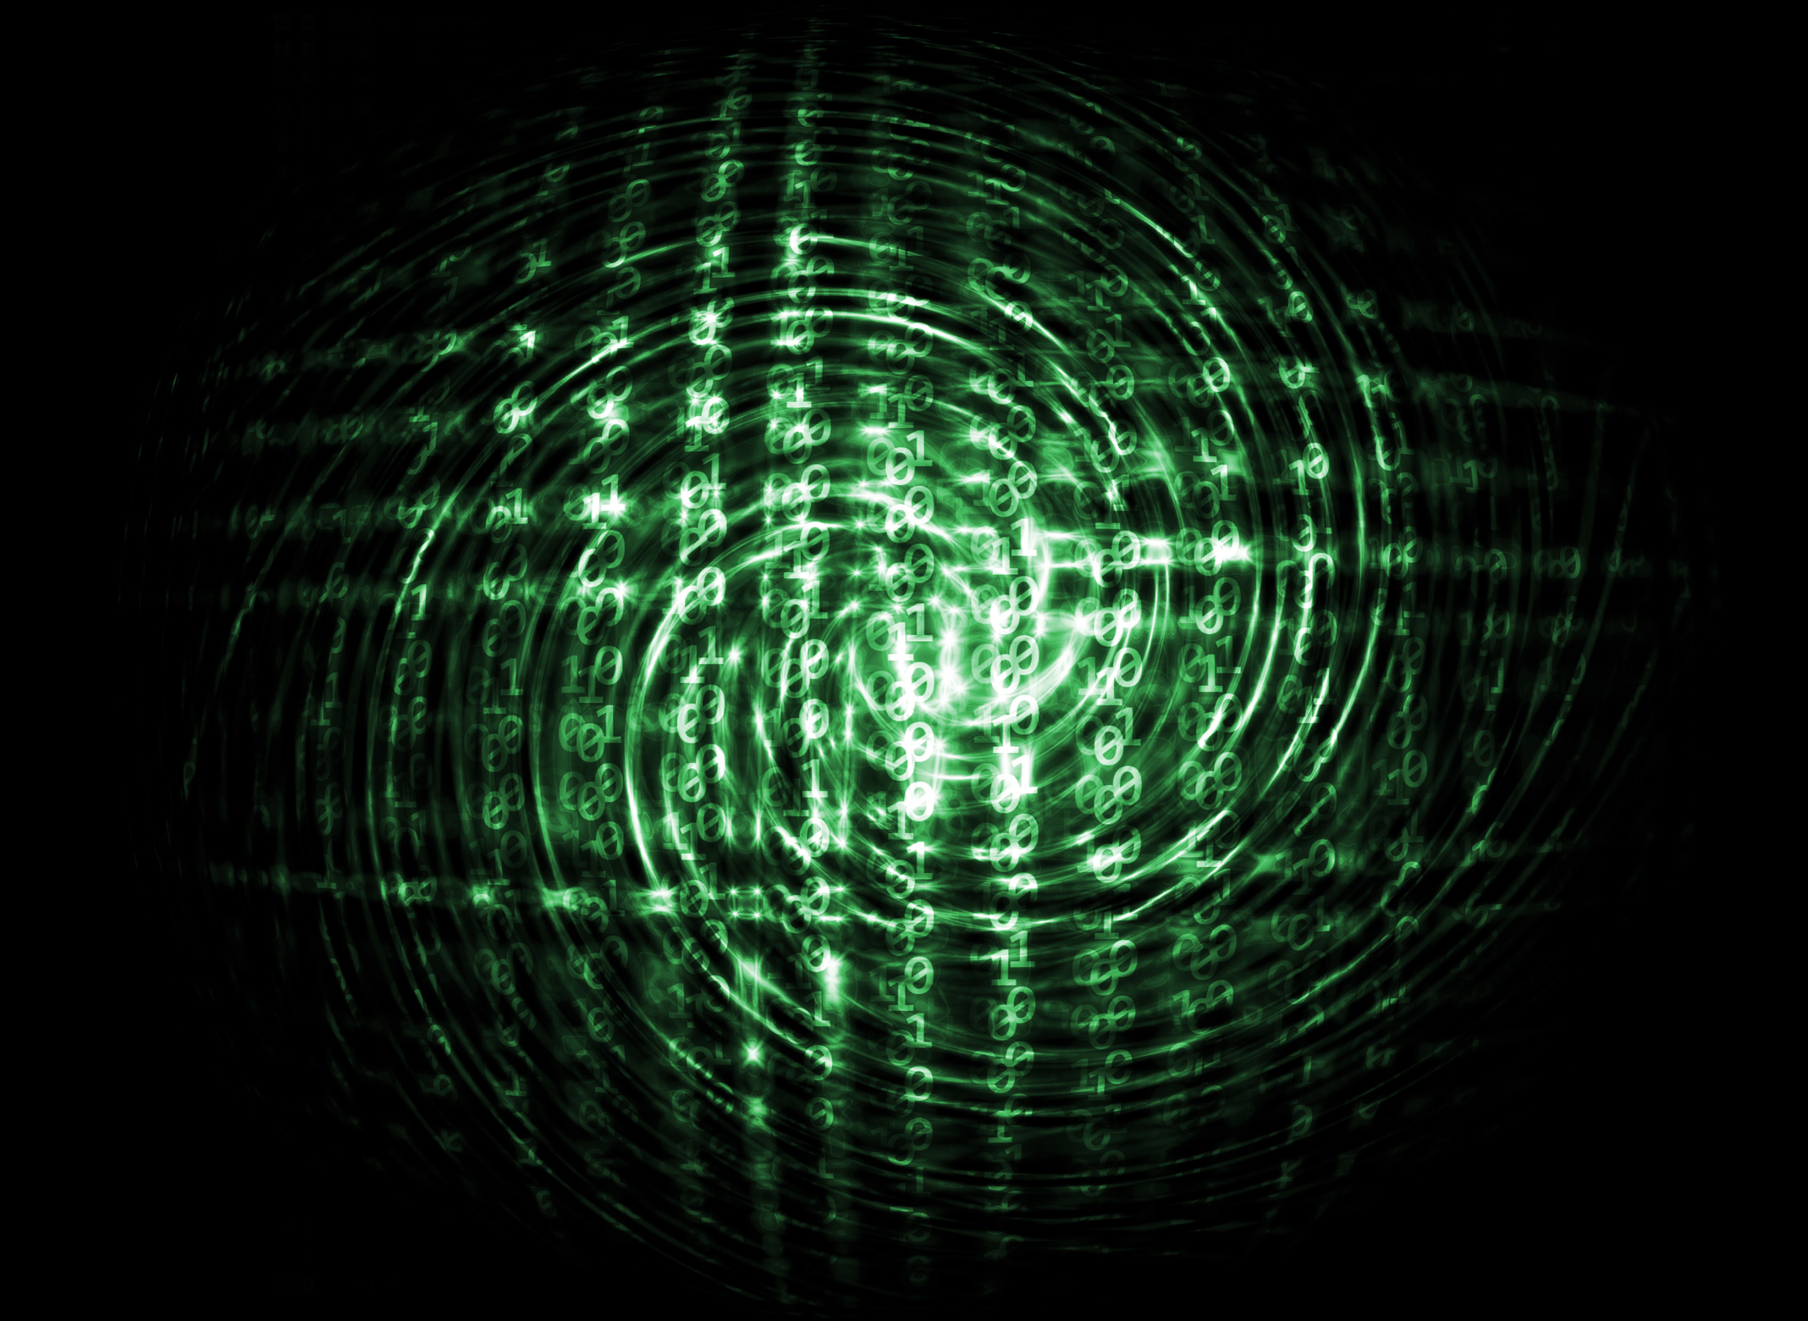
Collective Outliers (1)
Objects as a group deviate significantly from the entire data set
Need to examine structures, i.e., relationships between multiple data obiects
e.g., temporal, spatial, graph/ network
Different from contextual outlier detection
structures are often not explicitly defined
Reduce to conventional outlier detection
structure unit ==> "super" data obiect
Ravi Starzl, PhD - Data Mining Fall 2023
Notes:
Examining Structures:
To detect collective outliers, one needs to look at the relationships and structures formed by multiple data objects. This can be in the form of temporal patterns (over time), spatial patterns (across different locations), or in graph/network structures (how objects are interconnected).
For example, in a temporal analysis, a series of data points might be normal when viewed independently, but if they all occur in a short time frame, this could be flagged as a collective anomaly.
Contrast with Contextual Outliers:
While contextual outlier detection is concerned with whether an individual data point is an outlier within its context, collective outlier detection is interested in whether a group of points, when considered together, behaves anomalously.
The structures in collective outlier detection are often not explicitly defined and might not be immediately visible without analyzing the relationships between data points.
Transformation to Conventional Outlier Detection:
One approach to identifying collective outliers is to transform the structure into a "super" data object. This involves aggregating the data points in a way that represents the structure.
For instance, if analyzing temporal data for unusual spikes in activity, the structure might be the frequency of events within a time window. This structure could then be treated as a single data point.
Once transformed, conventional outlier detection techniques can be applied to these "super" data objects to identify collective anomalies.

Slide 14

Collective Outliers (2)
Model the expected behavior of structure unites directly
E.g., online social networks of customers
structure unit: subgraphs of the network
small subgraphs with very low frequency
large subgraphs that are surprisingly frequent
4 E.g., temporal sequences
learn a Markov model from the sequences; a subsequence that deviates from the model
Ravi Starzl, PhD - Data Mining Fall 2023
Notes:
Modeling Structure Units:
The first step is to define what constitutes a structure unit within the dataset. In the context of online social networks, for example, a structure unit might be a subgraph that represents a group of interconnected users.
The expected behavior of these structure units needs to be modeled based on the dataset. This could involve understanding common patterns, frequencies, and connections within the network.
Detecting Anomalies in Structure Units:
Once the model of expected behavior is established, you can begin to identify outliers by looking for structure units that deviate significantly from this model.
In social networks, anomalies might be small subgraphs that occur very infrequently but represent a significant deviation from the norm, or large subgraphs that are surprisingly common compared to what the model predicts.
Temporal Sequences:
For datasets involving temporal sequences, like time-series data, a Markov model can be a useful tool. Markov models can capture the transition probabilities between states in a sequence, effectively learning the typical patterns of behavior over time.
Once the model is trained, a subsequence that significantly deviates from the learned patterns — for example, a sequence of events that the model deems highly improbable — can be flagged as a collective outlier.
Example Scenarios:
Online Social Networks: Detecting collective outliers might involve finding subgraphs that represent unusual patterns of interaction among users — such as a sudden increase in connectivity that could indicate a coordinated campaign of some sort.
Temporal Sequences: In the case of temporal data, detecting a subsequence that does not follow the transition probabilities — such as a machine's operational data suddenly showing a pattern that has never been seen in the context of normal operation — can indicate a malfunction or an external intervention.

Slide 15

Outliers in High-Dimensional Data
﻿Data in high-D spaces are often sparse
object distances dominated by noise
﻿Interpretation of outliers
too many features, need to identify subspaces of the outliers
Subspaces that signifying the outliers
capture the local behavior of data
Scalable: #subspaces increases exponentially
Ravi Starzl, PhD - Data Mining Fall 2023
Notes:
Sparsity of Data:
In high-dimensional spaces, data points are often sparse and far apart from each other. This is sometimes referred to as the "curse of dimensionality."
Due to this sparsity, conventional distance measures may become less meaningful, as the distance between any two points tends to be large and dominated by noise.
Interpretation of Outliers:
When dealing with high-dimensional data, interpreting outliers becomes more complex because there are many features to consider.
It may be necessary to identify relevant subspaces where outliers are more apparent. These subspaces consist of a subset of the dimensions that can highlight anomalies that might be hidden when considering the full dimensionality.
Identifying Significant Subspaces:
The goal is to find subspaces that are significant for characterizing outliers. These are dimensions in which the data exhibits local behaviors that deviate from the norm.
However, the challenge is that the number of possible subspaces increases exponentially with the number of dimensions, making it computationally expensive to examine all possible subspaces.
Scalable Detection:
To address the scalability issue, methods have been developed that can efficiently search through the vast number of potential subspaces to identify those that are most relevant for detecting outliers.
These methods aim to capture the local behavior of data within subspaces where the effect of outliers is most pronounced.
Techniques such as random projection, feature selection, and ensemble learning can help in managing the dimensionality and finding outliers in a scalable manner.
Local Outlier Factors:
In high dimensions, it might be more effective to use algorithms that consider the local density of points, such as the Local Outlier Factor (LOF). The LOF measures the local deviation of a given data point with respect to its neighbors, with the idea that outliers will have a substantially different density compared to their neighbors.

Slide 16

Summary
Outlier & outlier analysis
Statistical approaches
Proximity-based approaches
Clustering-based approaches
Classification-based approaches
Mining contextual and collective outliers
Outlier detection in high dimensional data
Ravi Starzl, PhD - Data Mining Fall 2023

